Slide 1
What we can do - to what we do - so what we do - actually works. Fixing our traditional countermeasures
2019 SMSA National Training Summit
Planning for the Future of
Motorcyclist Safety
Dan Petterson - petterson@pobox.com
Skilled Motorcyclist Association – Responsible, Trained & Educated Riders
SMARTER at www.smarter-usa.org

Slide 2
Workshop Goals
1. Identify the goals of a comprehensive motorcyclist safety program
2. List common countermeasures
3. Review the research regarding the three most common countermeasures
4. Identify possible changes to these most common countermeasures

Slide 3
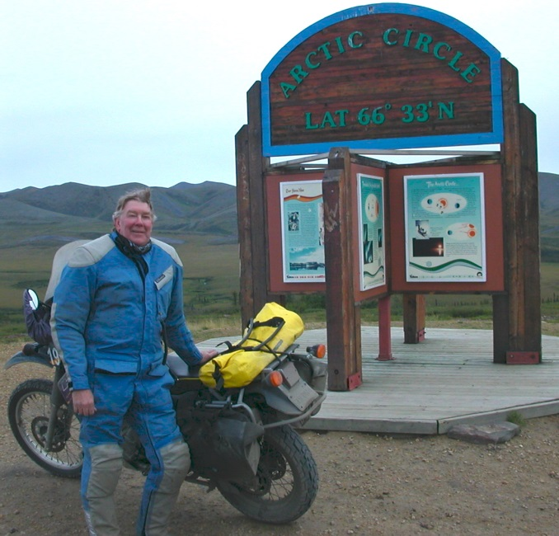
Introduction
I am President and CEO of SMARTER – the Skilled Motorcyclist Association – Responsible, Trained and Educated Riders, Inc. – SMARTER
A 501c3 non-profit founded in 2007 (not a rights organization)
www.smarter-usa.org

Slide 4
SMARTER’s Mission
To gather, examine, catalogue, share, post and distribute motorcyclist safety factual information and research and to
advocate for the use of such knowledge as the basis of decisions
Approx. 340 reports in 12 main categories . We are the one-stop spot for accessing research.
Gathering, reading, organizing and posting this research has been my volunteer job for more than a decade

Slide 5
Who is here?
State coordinators?
Coaches/instructors?
Program/site managers?
Quality assurance specialist's?
Coach/instructor trainers?
How many have visited our web site?

Slide 6
The goal or goals of Motorcyclist Safety
Talk with at least 2 others - brainstorm
Develop a list (3-5) of common goals of Motorcyclist Safety Programs
(3 minutes to talk)

Slide 7
Share one goal you identified with the full group

Slide 8
Three Goals
Three Goals of Comprehensive Motorcyclist Safety:
1. Reduce the number of crashes
2. Prevent deaths and injuries in the event of a crash and
3. Lessen the severity of injuries in the event of a crash.

Slide 9
Countermeasures
Talk with at least 2 others and identify 3-5 common countermeasures to address the goals.
What do motorcyclist safety programs do – what is implemented to accomplish the goal(s)?
(3 min)

Slide 10
Tell us a countermeasure you identified.

Slide 11
Common countermeasures
1. Rider training
2. Motorist awareness
3. Effort directed toward increasing the number of properly licensed riders
Additional efforts sometimes include
4. Effort directed toward increasing motorcyclist conspicuity
5. Effort directed toward encouraging riders not to drink and then ride

Slide 12
What does the research tell us?
If our goal is to reduce the number of crashes and thereby save lives, reduce injuries & maybe reduce the severity of injuries
THEN the research tells us
the traditional countermeasures (training, awareness and licensing) are not working

Slide 13
Rider Training – the research http://smarter-usa.org/research/training/
Pre 1980 very mixed results - more a reflection of the methods used to evaluate the training than the effectiveness of training itself
1981 – Hurt results : Riders make braking errors, lack ability to countersteer and swerve. Hurt results have huge impact on training content
1990 – Ouellet: Lane position a better alternative than depending on avoidance skills – little or no impact on training curriculum
1998 - Billheimer study Training only has short term positive impact for novice riders – little or no discussion on why or how training might be changed
2006 – Ouellet: Knowledge and skills needed to prevent a precipitating event from occurring is more important than how to react after it has already occurred
2000 – 2010 Literature reviews: No consensus in the literature for the common assumption that trained motorcyclists have fewer crashes
Most recent: There is emerging evidence for a positive effect of training aimed to improve perception, judgment and decision making

Slide 14
Rider Training Research Summary
We are stuck in 1982. We implemented ideas gleaned from the Hurt report and then to a large degree stopped responding the research.
Training is designed to teach riders how to operate a motorcycle and provide a path to gaining a proper license.
The available research provides little or no evidence that training reduces the likelihood of crashing. Several reports indicate that training increases the risk of crashing or increases risky behavior. The common assumption that trained motorcyclists have fewer crashes is not supported by the research.

Slide 15
Talk to someone about the research on rider training

Slide 16
Rider Training Research Summary
We are stuck in 1982. We implemented ideas gleaned from the Hurt report and then stopped reading and responding the research.
Training is designed to teach riders how to operate a motorcycle and provide a path to gaining a proper license.
The available research provides little of no evidence that training reduces the likelihood of crashing. Several reports indicate that training increases the risk of crashing or increases risky behavior. The common assumption that trained motorcyclists have fewer crashes is not supported by the research.

Slide 17
Comments or Questions
Regarding the research on rider training before we move on to Motorist Awareness

Slide 18
Motorist Awareness http://smarter-usa.org/research/motorist-awareness/
1981 Hurt Report: “The failure of motorists to detect and recognize motorcycles in traffic is the predominating cause of motorcycle accidents. The driver of the other vehicle involved in collision with the motorcycle did not see the motorcycle before the collision, or did not see the motorcycle until too late to avoid the collision.”
1982/3: AMA began the “Start Seeing Motorcycles” campaign & states took up the banner. We now have nearly 40 years of such campaigns.
But sadly there are no direct evaluations of the effectiveness (for reducing ROW violation caused crashes) of campaigns to increase driver awareness of motorcyclists.
We have posted three studies: Two indicate the probable likelihood of the ineffectiveness of MA campaigns and site possible reasons. The third sites lack of conspicuity and motorcyclist speed as more probable reasons for ROW violation crashes than the car driver failure to “look twice.”

Slide 19
Motorist Awareness -2
Stand alone communication/PR campaigns of any sort have little or no evidence of ever being effective. They do, however, make us feel good.
Awareness programs are based on the untested assumption that if drivers look twice, pay more attention, or are reminded that motorcyclists are on the road, they would actually “see” approaching riders and the result would be a reduction in motorcyclist right-of-way violations by other motorists
This assumption is inconsistent with the research on how our eyes and mind work together (inattentional blindness, change blindness, saccades)

Slide 20
Motorist Awareness Research Summary
1982: We implemented “awareness programs” that seemed logical based on the 1981 research
In four decades we have failed to evaluate those efforts
At the same time, we are ignoring more than a decade of relevant research regarding how our eyes and mind work to detect objects in our direct field of vision

Slide 21
Tell someone something about the research regarding motorist awareness

Slide 22
Motorist Awareness Research Summary
1982: We implemented “awareness programs” that seemed logical based on 1981 research
In four decades we have failed to evaluate those efforts
At the same time, we are ignoring more than a decade of relevant research regarding how our eyes and mind work to detect objects in our direct field of vision

Slide 23
Comments/Questions
Regarding the research on motorist awareness campaigns before we move to the research regarding licensing

Slide 24
Licensing Research Summary http://smarter-usa.org/research/licensing/
The effectiveness of motorcycle operator licensing for reducing crash risk, is not known.
There are no evaluations of whether increasing the proportion of motorcycle riders who are validly licensed reduces the number of motorcycles crashes.
Fatal crash statistics that show 30% or more of motorcycle operators killed in crashes are not properly licensed, However, to conclude that being properly licensed reduces the risk of being in a crash, would be an inappropriate conclusion.
We have to remember “Correlation does not imply causation.” A correlation between two variables does not imply that one causes the other. Unlicensed riders are also more likely to be alcohol impaired and unhelmeted.

Slide 25
Mini – update
1. Identified the goals of a comprehensive motorcyclist safety program
2. List common countermeasures
3. Review the research regarding these countermeasures
4. Identify possible changes to what we do

Slide 26
What we can do to what we do so what we do actually works? - Training
Talk with at least 2 others – brainstorm
What rider characteristics are associated with a low (or lower) risk of crashing?
(3 minutes)

Slide 27
What are some of these characteristics?

Slide 28
Changes - training
Increase focus on attitudes toward risk taking. More focus on
decision making and responsibility
Increase the focus and time dedicated to hazard perception
Design training programs that offer a progression to on-road riding and developing riding in traffic skills through on-road experience.
If the goal of government sponsored programs is to reduce crash risk then government sponsored programs should consider increasing the focus of training on above noted topics.
Private venders can teach the physical skills – stop allocating government $ to skills training.

Slide 29
If the goal of government sponsored programs is to reduce crash risk and injury in the event of a crash then government sponsored programs should consider increasing the focus of training on above noted topics.
Private venders can teach the physical skills – stop allocating government $ to skills training.
Tell someone what you think about this statement.

Slide 30
Comments/Questions
Comments/questions regarding “what we might do to what we do (training) so what we do (training) actually works”

Slide 31
Changes - licensing
Licensing processes need to move away from a skill focus to a responsibility focus (in conjunction with changes in training).
Consideration should be given to graduated licensing systems designed to provide new motorcycle riders with operating experience gradually over time in low-risk environments.
Tiered licensing could also be considered. Tiered licensing requires beginner riders to purchase machines with restricted horsepower levels.
A combination graduated and tiered might be most effective.

Slide 32
Changes - motorist Awareness
Motorist focused programs need more than simple reminders.
The old “look left, look right, look left again” and go is antiquated and ineffective.
We have current research about “looked but failed to see right-of-way violation” caused crashes and two decades of research about how our eyes and mind work together to see – which we are not using to teach motorcyclists better ways to approach intersections and motorists to perceive vulnerable road users.
Motorists should be taught a specific system for looking for vulnerable road users – motorcyclists, bicyclists, and pedestrians.

Slide 33
Countermeasures that work: indications from the research
A strong government role in setting legislation and policy enforcement
Strong police enforcement - alcohol, speeding, helmet use
Improving post-crash response
Graduated/tiered licensing
Conspicuity enhancements for rider and machine including standardized unique frontal lighting
Anti-lock brakes & stability control systems
Alcohol interlocks
Black (blind) spot treatments
Protective gear use – armor & air bag gear
And of course the # 1, considered the only scientifically proven countermeasure for preventing death and injury in the event of a crash

Slide 34
The use of a helmet
Helmets, full gear and helmet laws to prevent deaths, injuries and/or reduce the severity of injury in the event of a crash.
The statement “helmets don’t prevent crashes” assumes the only acceptable goal is to prevent crashing.
This position ignores the fact that crash rates remain high and the research that indicates traditional countermeasures have little evidence of effectiveness for preventing crashes.
If we are not reducing the number of crashes, then reducing death and injury and severity of injury in the event of a crash, become even more important goals.

Slide 35
What will you do so what your state does actually works?
Read the research at
www.smarter-usa.org
Dan Petterson
petterson@pobox.com
smarterusa@gmail.com

